Slide 1
Inmate Visitation System Why We All Need It

Slide 2
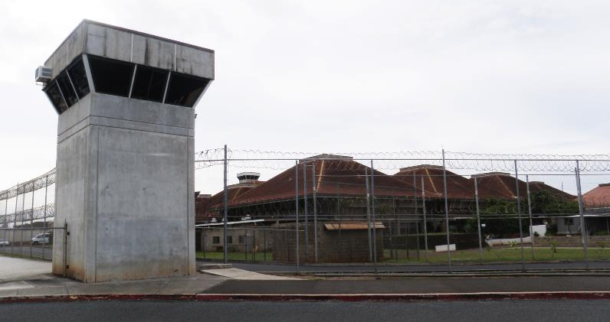
Oahu Community Correctional Center (OCCC)
Notes:
Introductions
Years of service and titles

Slide 3
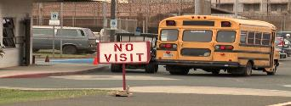
Data
The Oahu Community Correctional Center (OCCC) is the largest jail facility in the State of Hawaii.
The 950-bed facility houses 1300 detainees.
Each inmate can have up to 12 visitors on their list.
Over 8,000 visitors are approved right now
Notes:
Erin:The Oahu Community Correctional Center (OCCC) is the largest jail facility in the State of Hawaii with a high turnover rate of detainees.
The 950-bed facility houses 1300 pre-trial detainees.
Each inmate can have up to 12 visitors on their list.
Over 8,000 visitors are approved right now

Slide 4
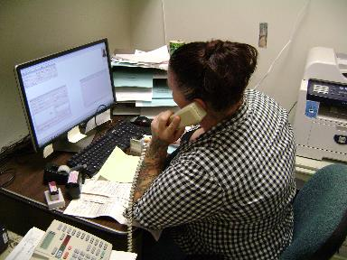
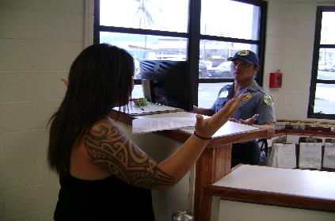
The Challenges Staff Faces
Scheduling 55 visits a day, 7 days a week
Staff over-taxed
Constant verification of information
Visitor guidelines are understood
Notes:
Major: Scheduling 55 visits a day, 7 days a week using only one phone line, with limited hours and days that visitation staff work.
Staff scheduling visits are in charge of other work duties that will be neglected.
Constantly making sure information is correct, no double bookings for the same inmate. Separating male and female offender visits.
Ensuring that visitors have the right forms and know the dress codes.

Slide 5
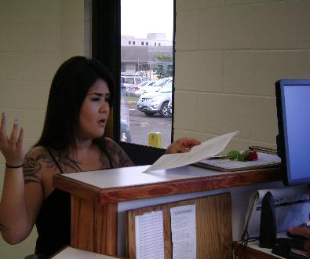
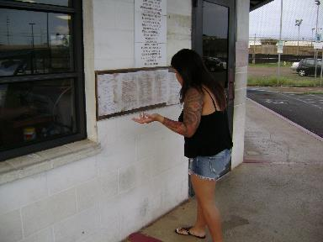
Challenges Visitors Face
Visits may be disapproved
Constant busy signal when calling.
Scheduling closed during off hours and holidays.
Failure to verify visit approval
Notes:
Erin: Visits can be delayed or turned away if visitor is dressed inappropriately, does not have the right forms filled out correctly, or comes at the wrong times.
Constant busy signal when calling.
Finally getting through only to find out staff is off duty, not working that day, or reassigned for that day.
Assuming they are approved, but do not come in to check with front gate Officer

Slide 6
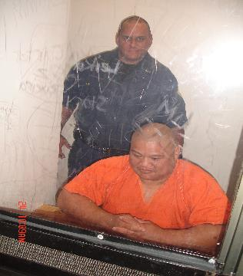
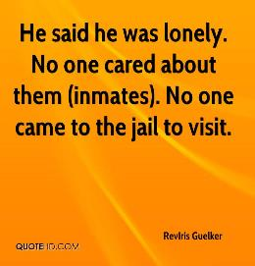
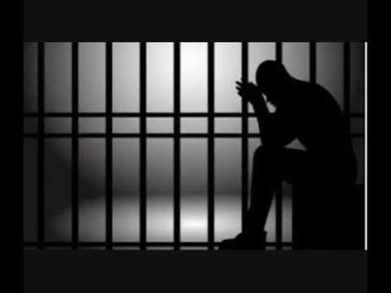
Challenges Inmates Face
Not being in contact with loved ones.
Notes:
Major J

Slide 7
Need
A way to efficiently streamline visit scheduling process.
Visitors frustration reduced
Alleviate staff stress and multitasking
Promote positive socialization for detainees
Notes:
Erin

Slide 8
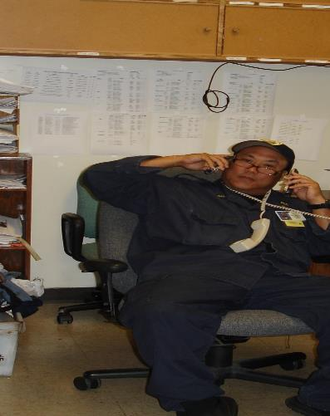
HELP US!
Notes:
Major J

